Slide 1

AGE 310: Instrumentation and Measurements
Lecture 8: Digital Logic & Microcontrollers
Instructor: Dr. Kadeghe Fue
Department of Agricultural Engineering
Sokoine University of Agriculture (SUA)

Slide 2


Recap & Objectives
Recap: Lecture 7
Lecture 8 Objectives
We discussed Actuators (Motors, Solenoids, Hydraulics) - the "muscles" of our control systems.
Understand Binary Logic and Number Systems.
Master basic Logic Gates (AND, OR, NOT).
Differentiate Microcontrollers (MCU) from Microprocessors (MPU).
Introduction to the Arduino platform.
Ag Application: Automated Greenhouse Control.

Slide 3







Why Digital?
Why do we convert our continuous analog world into 0s and 1s?
Noise Immunity
Storage
Programmability
Digital signals are robust. A "1" is clearly distinct from a "0", even with some electrical noise.
Data can be stored cheaply and indefinitely without degradation (SD Cards, Hard Drives).
We can change the behavior of a system just by changing code, not rewiring hardware.

Slide 4

The Language of Computers: Binary
Base-10 (Decimal)
What we use. Digits 0-9.
Example: 154 =
Base-2 (Binary)
What computers use. Digits 0 and 1.
Example: 1011 = = 11 (Decimal)

Slide 5

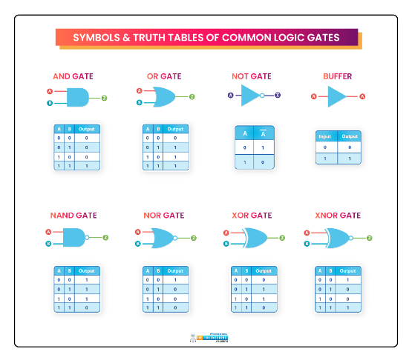
Basic Logic Gates
The Building Blocks
Logic gates are physical devices that implement Boolean functions.
AND: Output is 1 only if BOTH inputs are 1. (Series Circuit)
OR: Output is 1 if EITHER input is 1. (Parallel Circuit)
NOT: Inverts the input (1 becomes 0).

Slide 6
Truth Tables
AND Gate
OR Gate
A | B | Out
0 | 0 | 0
0 | 1 | 0
1 | 0 | 0
1 | 1 | 1
A | B | Out
0 | 0 | 0
0 | 1 | 1
1 | 0 | 1
1 | 1 | 1

Slide 7
Application: Safety Interlock
The Problem
The Logic
We want a tractor PTO (Power Take-Off) to turn ON only if:
This is a classic AND function.
Output =
1.
The operator is sitting in the seat (Sensor A = 1).
If the operator stands up (A=0), the PTO stops immediately, preventing accidents.
2.
AND the master switch is ON (Sensor B = 1).

Slide 8

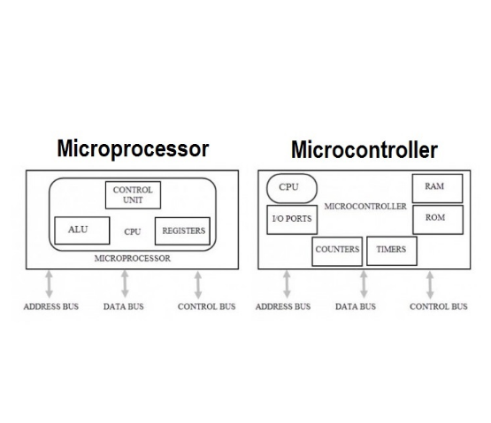
Microcontroller (MCU) vs Microprocessor (MPU)
Microprocessor (MPU)
The "Brain" (CPU) only. Needs external RAM, ROM, and I/O. Powerful, expensive. (e.g., Intel i7 in your laptop).
Microcontroller (MCU)
A "Computer on a Chip". Contains CPU + RAM + ROM + I/O pins all in one package. Cheap, low power. (e.g., Arduino ATmega328).

Slide 9
The Arduino Platform
What is it?
Why use it in Ag Engineering?
An open-source electronics platform based on easy-to-use hardware and software.
Rapid Prototyping: Quickly test ideas (e.g., smart irrigation).
Low Cost: Boards cost < $20.
It acts as the "Brain" for agricultural automation projects.
Huge Community: Thousands of libraries for sensors (Temp, GPS, Soil Moisture).

Slide 10
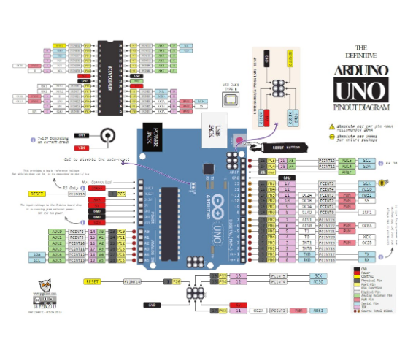
Anatomy of an Arduino Uno
Digital Pins (0-13): On/Off signals (Switches, LEDs).
Analog Pins (A0-A5): Read varying voltage (Sensors).
Power: 5V and 3.3V output for sensors.
USB: For programming and serial communication.

Slide 11






Digital Input / Output (I/O)
digitalRead(pin)
digitalWrite(pin, value)
Reads the state of a pin.
Sets a pin to 5V or 0V.
Returns HIGH (1) or LOW (0).
Example: Turning a relay (pump) ON or OFF.
Example: Detecting if a water tank float switch is up or down.

Slide 12


Analog Input (ADC)
analogRead(pin)
Example Calculation
The Arduino has a 10-bit ADC.
If the sensor outputs 2.5V:
It maps 0-5V input voltages to an integer value between 0 and 1023.

Slide 13
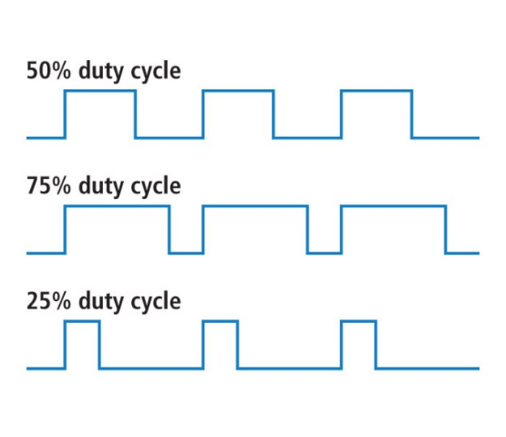
Simulating Analog Output: PWM
Pulse Width Modulation
Microcontrollers are digital (can't output 2.5V directly). Instead, they switch 5V ON and OFF very fast.
Duty Cycle: The % of time the signal is HIGH.
50% Duty Cycle ≈ 2.5V Average.
25% Duty Cycle ≈ 1.25V Average.
Used for dimming LEDs and controlling motor speed.

Slide 14
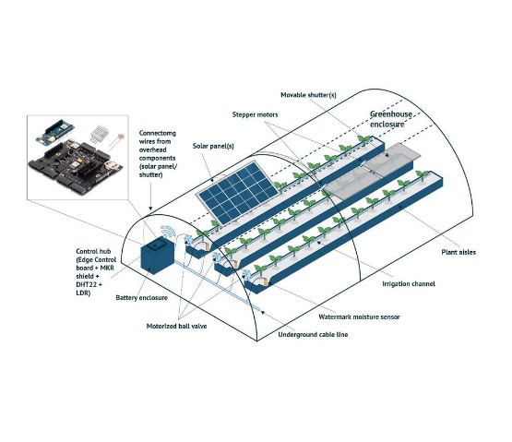
Ag Application: Smart Greenhouse
The Control Logic
Input: Temperature Sensor (Analog A0).
Processing:
if (temp > 30) { digitalWrite(FAN, HIGH); }
Output: Relay Module connected to Exhaust Fan (Digital Pin 8).

Slide 15
Data Logging & Telemetry
Local Logging
Telemetry (IoT)
Using an SD Card Module to save sensor readings (CSV format) every 10 minutes.
Sending data via Wi-Fi (ESP8266) or GSM to a cloud dashboard.
Good for remote stations without internet.
Allows real-time monitoring of the farm from a smartphone.

Slide 16

Discussion & Questions
End of Lecture 8
Assignment: Draw a logic circuit (using AND/OR gates) for a watering system that turns ON only if Soil Moisture is LOW OR the Manual Override button is PRESSED.
Dr. Kadeghe Fue | AGE 310 | SUA

